Slide 1

BIRLA INSTITUTE OF TECHNOLOGY MESRA, RANCHI
DEPARTMENT OF ELECTRONICS AND COMMUNICATION ENGINEERING
Internship Presentation On
Splunk Log Parser – An AI Driven Tool
INDUSTRY MENTOR:
Paritosh Dwivedi
PRESENTED BY:
Honey Pradhan (BTECH/10168/21)
INSTITUTE MENTOR:
Dr Prajna Parimita Dash

Slide 2
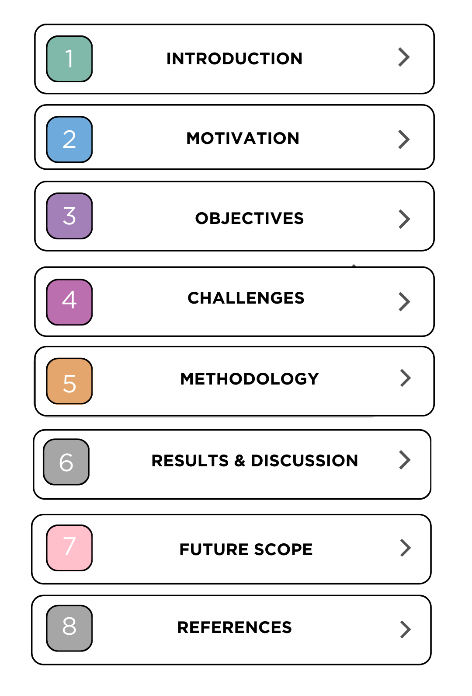
CONTENTS

Slide 3


Our Purpose is People
WHO
we are
WHY
WE'RE ON A MISSION TO
we exist
Inspire every organization to become a great place to work through technology built for all
CULTURE
PRODUCT
SERVICES
WHAT
Lead through Culture.
Innovate with Purpose.
Partner for Life.
customers
can expect
Connect culture insights and business outcomes to realize what’s possible when you invest in your people.
Build great experiences with solutions
designed for all people and all roles—meeting employees where they are on their journey.
Experience service that accelerates
value, promotes confidence, and ensures
long-term success.
OUR VALUES
HOW
United, Kind, and Growing
EVP
BEI
ESG
we show up
United by purpose. Inspired by you.
Uniquely You. Uniquely Valued. Uniquely Empowered.
Building great places to work. And better places to live.
WHERE
OUR STRATEGIC WRAPPER
we are
focused for
FY24
Inspire Greatness in every person, every workplace, every solution and every interaction.
Notes:
This slide represents UKG’s foundation: who we are, as an organization, why we’re here, why we’re unique, and the incredible opportunity we have in front of us for FY24 and beyond.
When we combine all these elements, you have the framework that defines UKG
And we’re going to share that framework throughout the year at things like state of and other big meetings, to align us all around where we’re going as an organization.

Slide 4
INTRODUCTION
UKG (Ultimate Kronos Group) is a leading provider of human capital management (HCM) solutions, designed to help organizations manage their workforce effectively.
Our Differentiation Strategy: Deliver Cloud HCM and Workforce Management that goes beyond the market standard of boosting operations.
Custom Function Cloud (CFC): CFC is a platform designed to run multi-tenant applications built on the External Dimensions Application Platform (EDAP).
Splunk is widely used for log management, allowing organizations to collect, index, and analyze log data from various systems. This is essential for troubleshooting, compliance, and security monitoring.
Daily monitoring of logs is a crucial practice for maintaining system health, security, and performance. It involves regularly reviewing log files from various sources such as servers, applications, networks, and security devices.
.

Slide 5
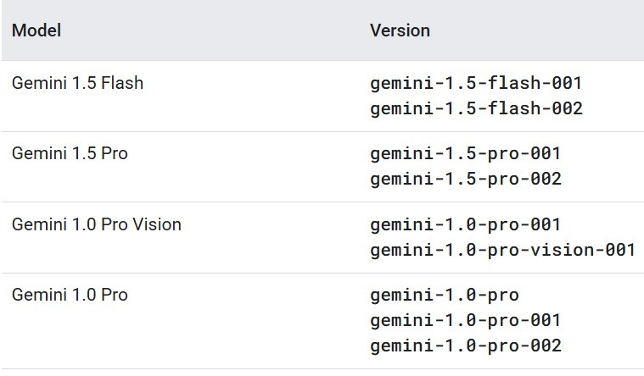
MOTIVATION
Efficiency Improvement: The primary motivation is to enhance the efficiency of log management processes by automating the parsing and filtering of log data, reducing the time and effort required for manual analysis.
Automated Log Parsing: Develop a robust AI-driven mechanism that automatically parses logs from various sources, ensuring consistency and accuracy in data extraction.
Real-Time Monitoring: Enable real-time monitoring of log data to facilitate immediate detection of anomalies and performance issues, enhancing operational responsiveness.
Integration with other applications: Once the application is tested well, ship it to various other organizational applications.

Slide 6
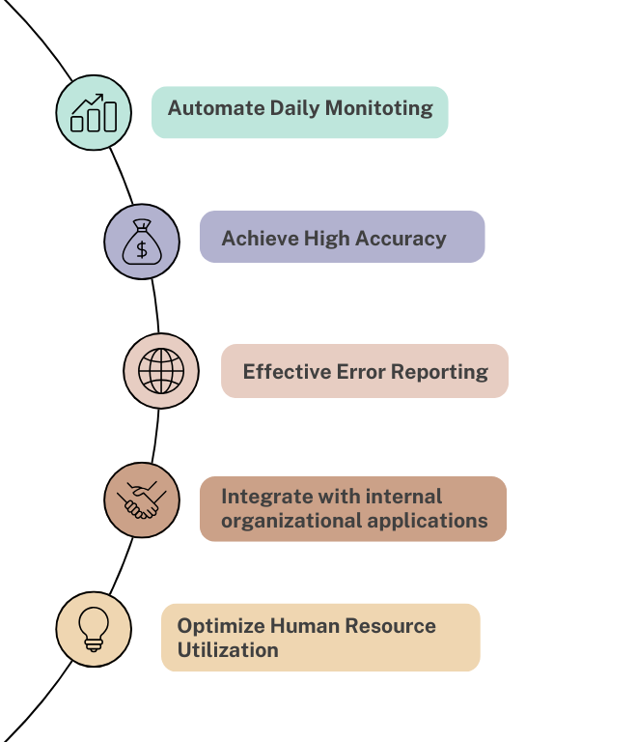
OBJECTIVES

Slide 7
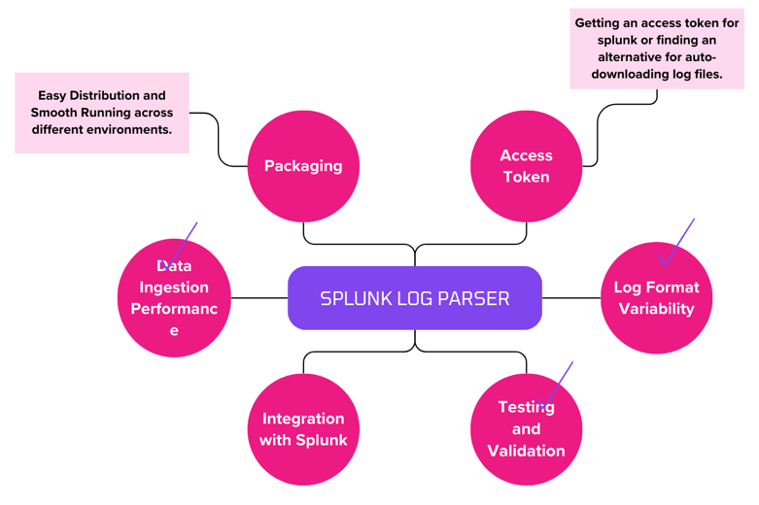
CHALLENGES

Slide 8
METHODOLOGY
Fixed a vulnerability in the Master Rotation Application involving a version update of npm, raised a PR, and successfully got it approved. Gained hands-on experience with Kubernetes
Analyzed the Splunk Enterprise interface to understand its functionalities and log management capabilities.
Exported and processed log files for further analysis.
Explored the Vertex AI framework over Google Cloud Platform(GCP), evaluating its various models and capabilities for AI-driven applications. Explored prompt engineering, optimizing AI interactions for improved model performance and accuracy.
Developed an AI-powered log parsing tool leveraging the Gemini-2-Flash-001 model to automate the parsing of large log files efficiently.

Slide 9
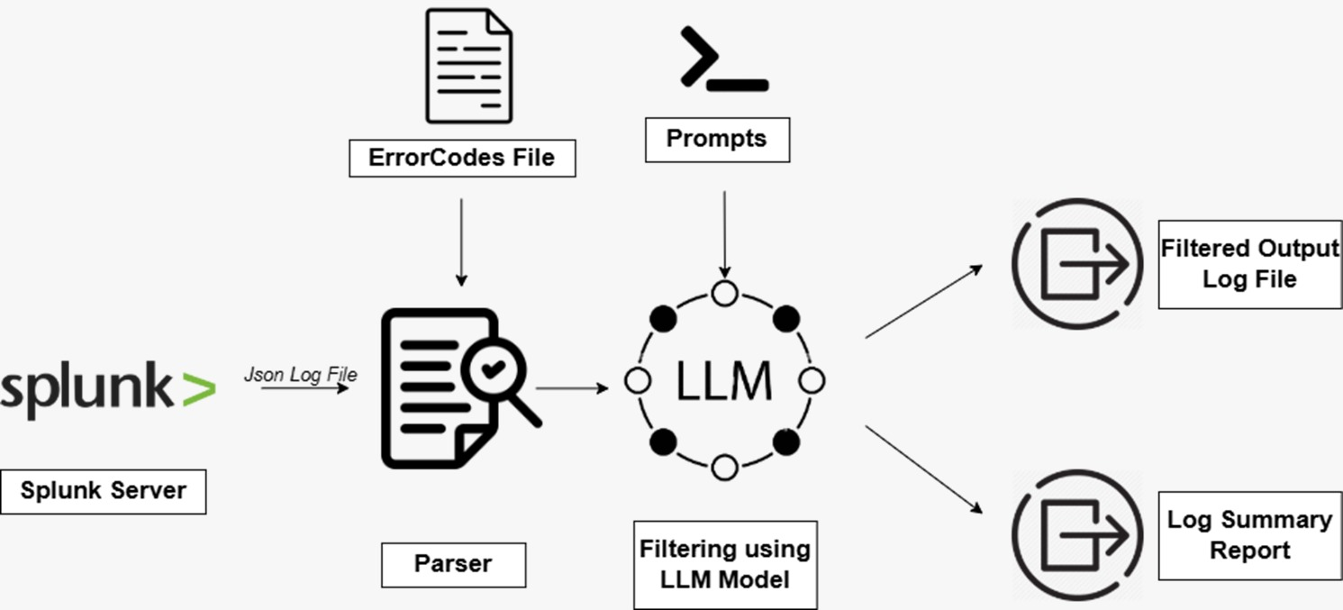
METHODOLOGY

Slide 10
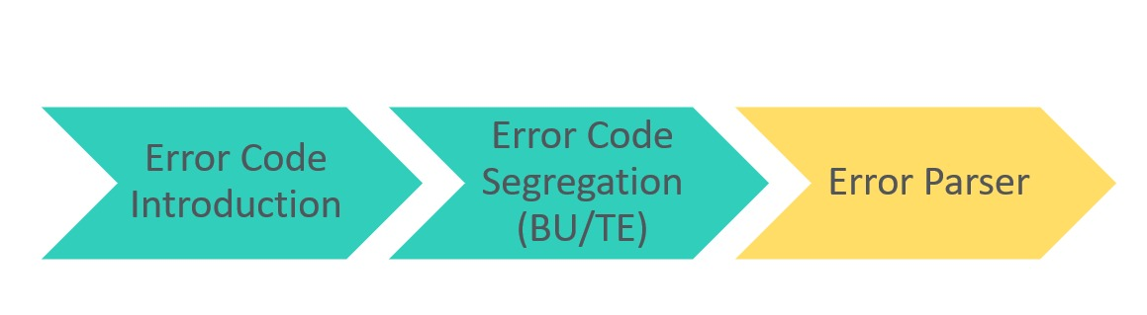
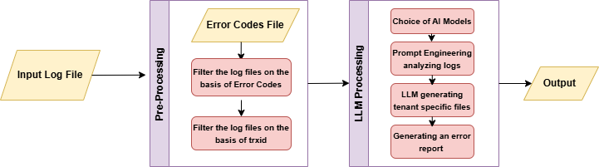
APPLICATION OVERVIEW

Slide 11









TOOLS AND TECHNOLOGIES USED
Visual Studio Code: Integrated Development Environment.
GitHub: Version Control System
GCP: Vertex AI Framework
GitHub: Remote Repository
Postman: API Testing
Docker
Splunk: Downloading Log Files
Vertex AI Framework: Various LLMs
11

Slide 12
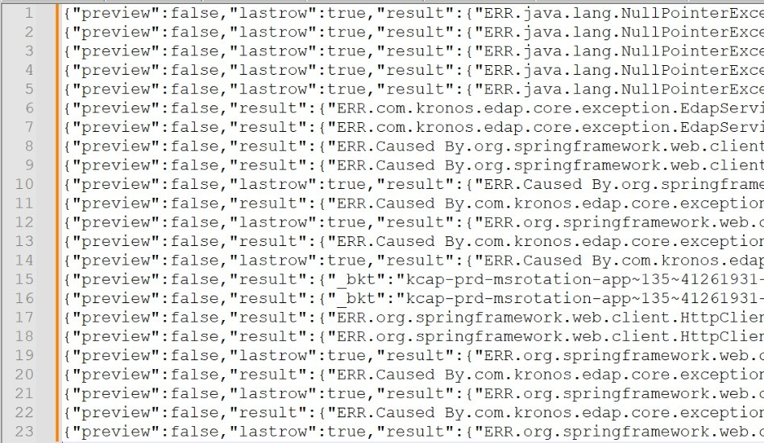
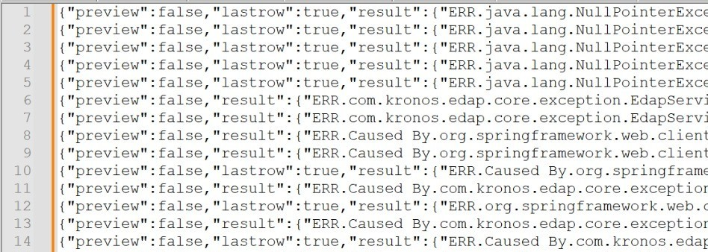
RESULTS & DISCUSSION
(a) Input Log File downloaded from Splunk(23 log lines)
(b) Intermediatory Output out of Pre-Filter(14 log lines)

Slide 13
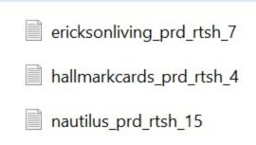

RESULTS & DISCUSSION
(c) Final Filtered Log Lines split into
corresponding tenant files using AI Model
(d)One of the tenant files
(e) Log Summary Report having details of number of impacted tenants with corresponding error codes

Slide 14
FUTURE SCOPE
Packaging & Deployment Across Multiple Applications: Develop a standardized package for seamless integration with various enterprise applications.
Extending it further in such a way that it can be utilized with all the microservices.
Automated Log Retrieval from Splunk: Enable direct integration with splunk for automatic log file downloading.

Slide 15
REFERENCES
Google Cloud API Reference
Vertex AI Reference
UKG Confluence
Python Reference
Splunk REST API Reference

Slide 16
THANK YOU

